Slide 1



Session :
Neural Network
Convolutional Neural Network
1
Notes:
1

Slide 2
Outline
Artificial Neural Networks
Overview
Structure
Convolutional Neural Networks
Histogram
Brightness Enhancement
Contrast Enhancement
Notes:
2

Slide 3
What are Artificial Neural Networks?
An Artificial Neural Network (ANN) is an information processing paradigm that is inspired by the biological nervous systems, such as the human brain’s information processing mechanism.
The key element of this paradigm is the novel structure of the information processing system. It is composed of a large number of highly interconnected processing elements (neurons) working in unison to solve specific problems. NNs, like people, learn by example.
An NN is configured for a specific application, such as pattern recognition or data classification, through a learning process. Learning in biological systems involves adjustments to the synaptic connections that exist between the neurons. This is true of NNs as well.

Slide 4
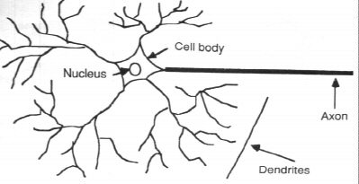
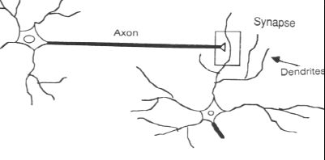
How the Human Brain learns
In the human brain, a typical neuron collects signals from others through a host of fine structures called dendrites.
The neuron sends out spikes of electrical activity through a long, thin stand known as an axon, which splits into thousands of branches.
At the end of each branch, a structure called a synapse converts the activity from the axon into electrical effects that inhibit or excite activity in the connected neurons.

Slide 5
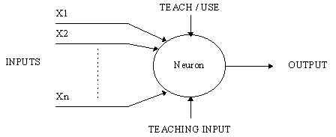
A Simple Neuron
An artificial neuron is a device with many inputs and one output.
The neuron has two modes of operation;
the training mode and
the using mode.

Slide 6
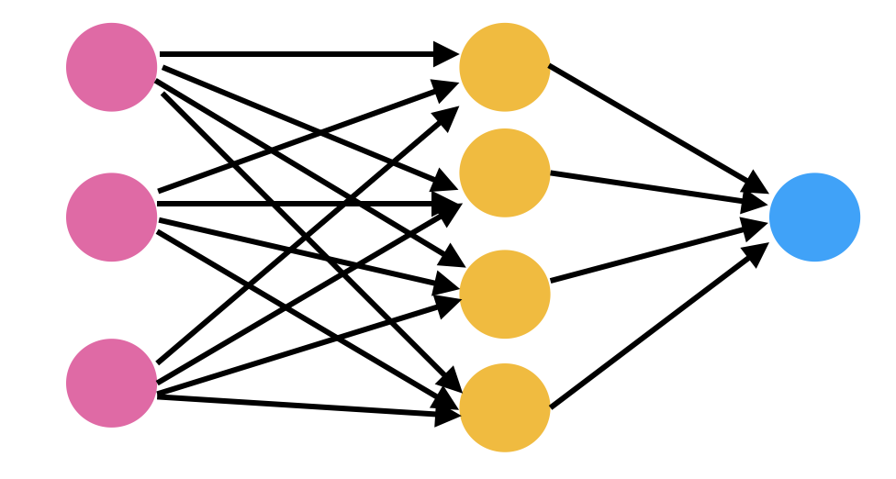
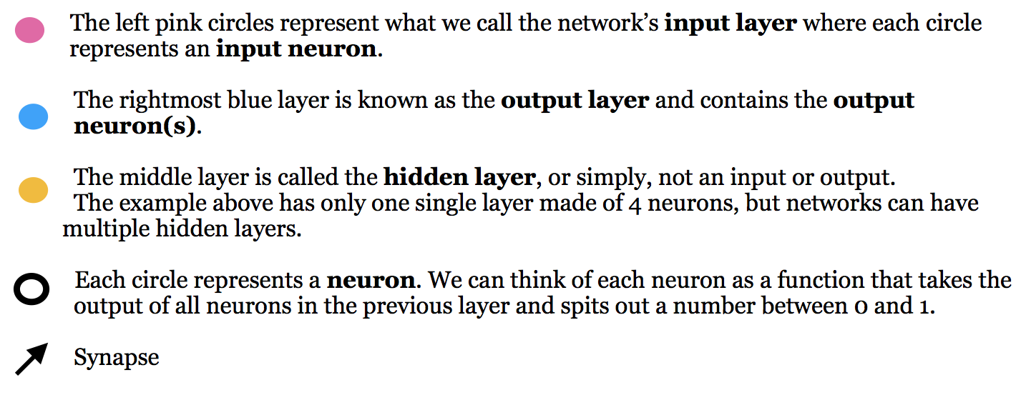
Structure of Neural Networks

Slide 7
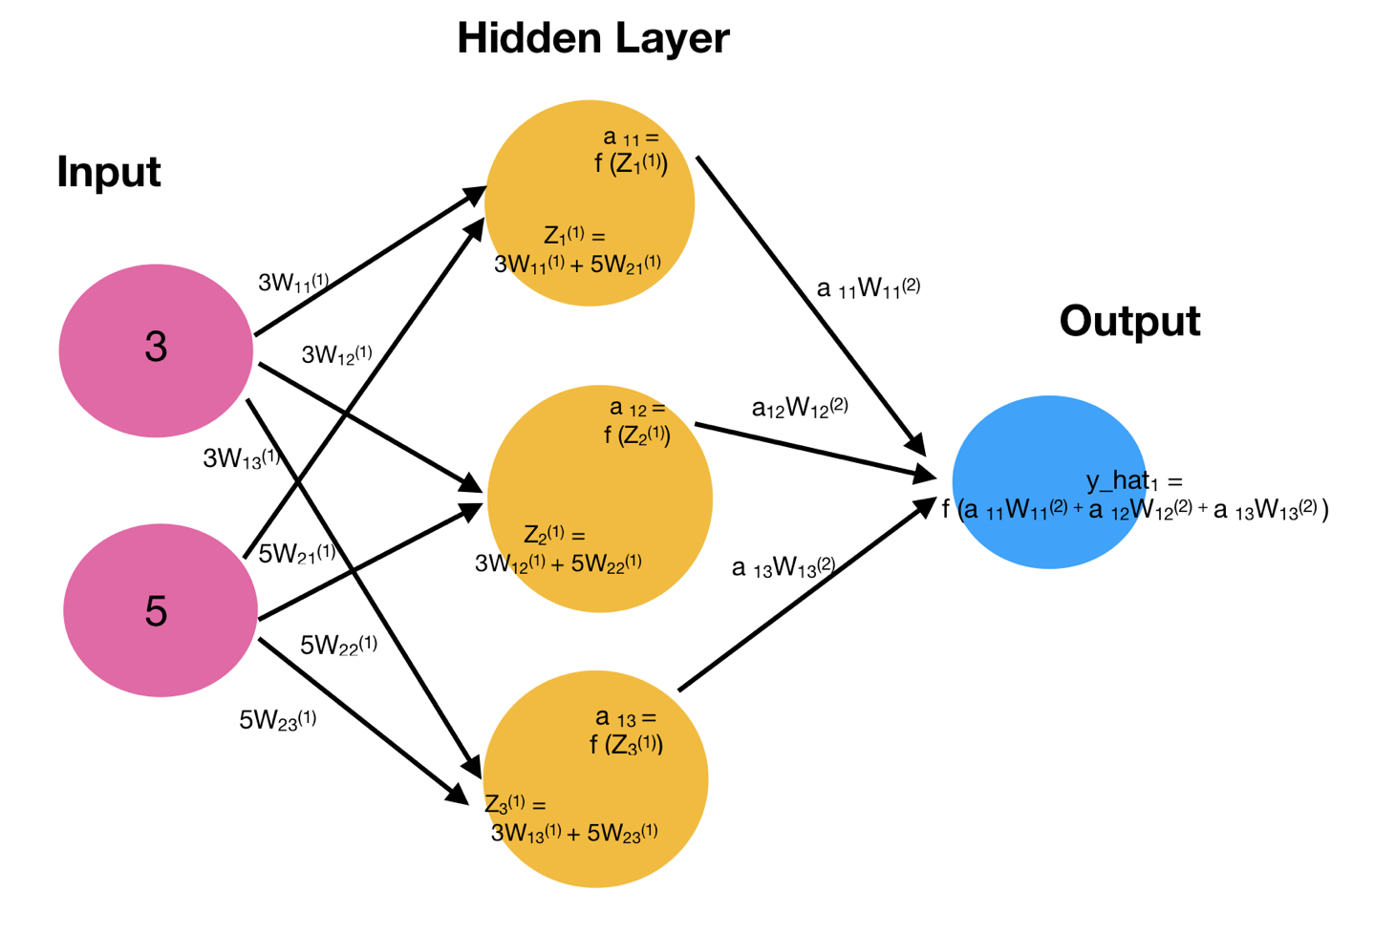
Hidden Layer

Slide 8
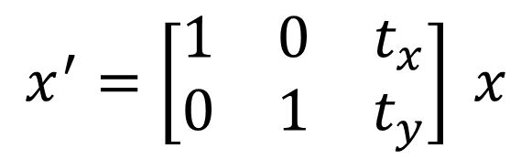
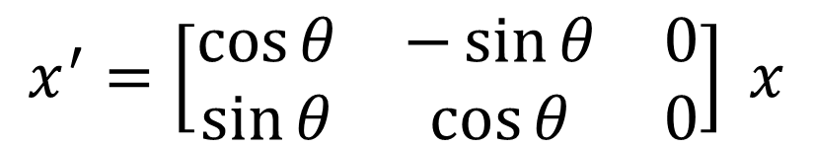
Geometric Transformation

Slide 9
Thank you!

